Slide 1
AWS Serverless Architecture
Agenda:
Cloud Computing
Serverless Architecture

Slide 2
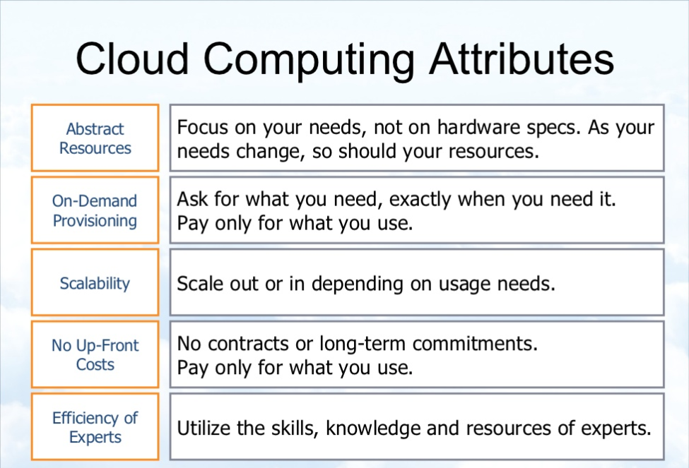

Slide 3




Serverless Architecture
Authentication
HTTP End Point
Compute Service
Client
AWS
IAM
API GATEWAY
API Lambda

Slide 4
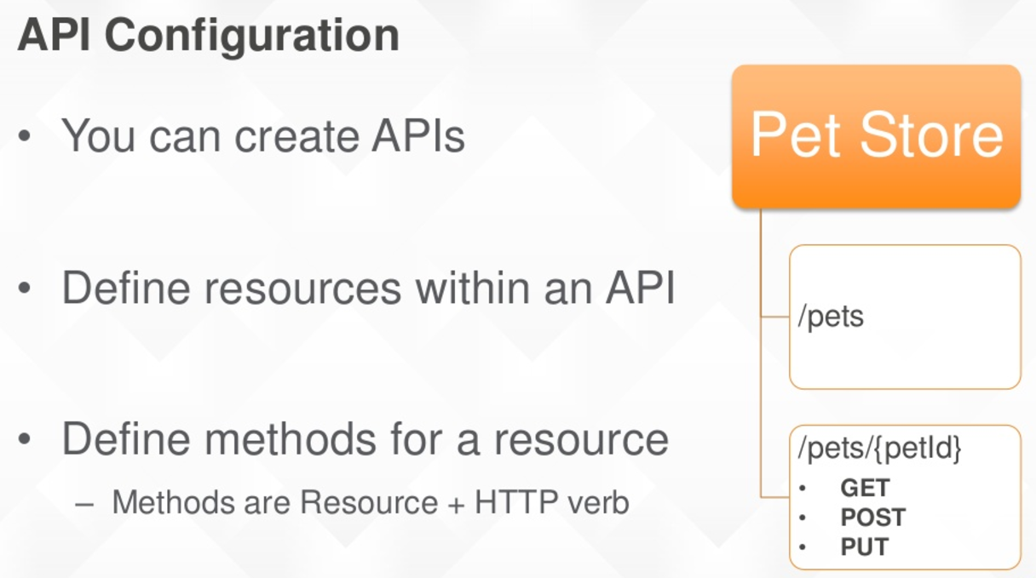

Slide 5
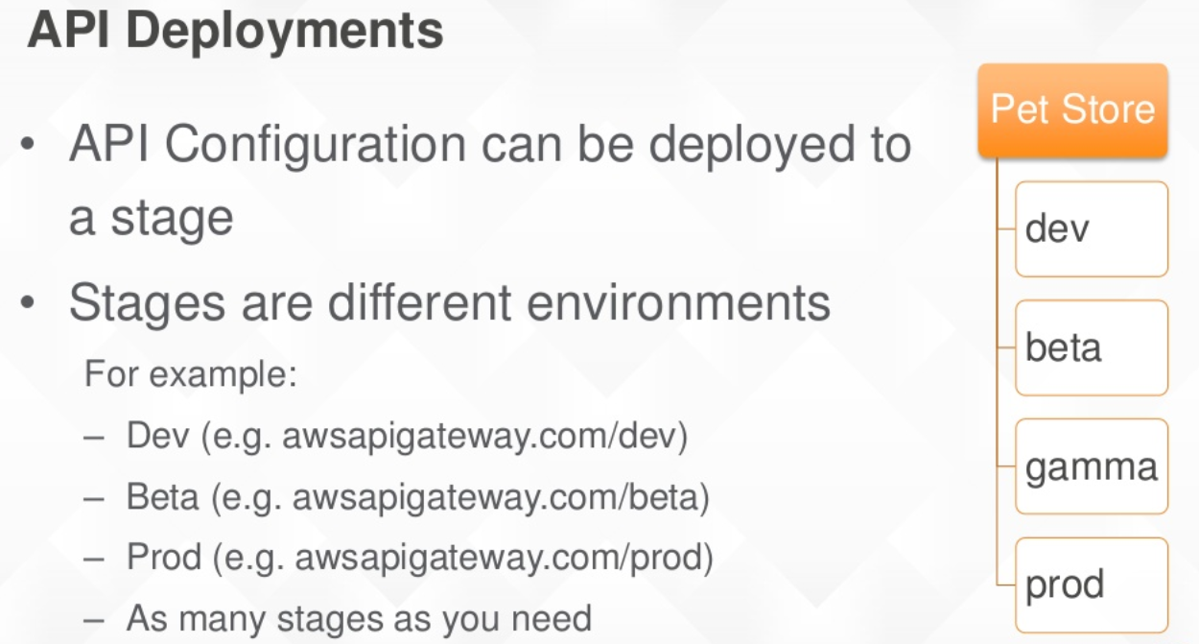

Slide 6
